Slide 1
Academic performance, Physics
Transition to Living and Learning Workshop
26th June 2012

Slide 2
Prof. Christian Knigge
Project background
Transition to Living and Learning project
Dr Andy Gravell
Associate Dean (Education and Student Experience)
Deputy Head of School (Education)
Physics and Astronomy
Faculty of Physical and Applied Sciences

Slide 3
Project overview
Failing modules?
Are students underperforming?
Possible reasons for this?
The transition experience
Recommendations?
Repeating?
Prior maths?
School type?
Engagement?
Induction?
Admissions?
Mentoring?
Notes:
This project has four broad aims.
investigate further the degree to which undergraduate students in Physics and Astronomy are underperforming, in the sense of failing modules and repeating study.
investigate the possible reasons for students’ underperformance. Particular attention will be paid to the possible connections between performance and prior mathematical education, between performance and general entry standards, and between performance and type of previous education.
examine the transition experience of the current 1st year physics undergraduates, with a focus on their engagement and the impact of induction.
form recommendations that may encourage a lower rate of module failures, referrals, and repeat study years with future intakes.

Slide 4
Data and analysis
Quantitative analysis
Previous school type
UCAS/A-level points
Attendance at labs
Personal characteristics (age, UK/non-UK etc.)
Results from first year exams
Performance relative to school peers
Coursework marks
Qualitative analysis
Lecturer interviews
Student focus groups
Interviews with PhySoc committee
More to come
Notes:
The research is split between the initial quantitative analysis and later qualitative investigation.
The quantitative research will look in depth at data, and will try to locate patterns.
The qualitative research aims to probe in greater depth the patterns indicated by the quantitative results. It will utilise the views of both staff and students, and seek to gain greater insight into the thoughts of those students failing to successfully transition.

Slide 5
Important Notes
Basic sample: UG physics students who began course at UoS 200708 or later
Data only includes students who enrolled (non-show students excluded)
Cohort year taken to be year in which student first fully enrolled
Module results considered are the core modules for the Physics UG courses
Notes:
So a 200708 applicant who deferred and first fully enrolled in 200809 is counted as part of 200809 cohort. Since the point was not to analyse application trends, but to analyse the performance of students once they arrived here.

Slide 6
Context
Increasing numbers of Physics undergraduates
No major curriculum reform in this period
Introduction of Mastering Physics, an online problem sheet system
Notes:
Also changes in lecturers, as usual.
Changes in Faculty/School structure more recently.

Slide 7
To what extent are UG physics students underperforming?

Slide 8
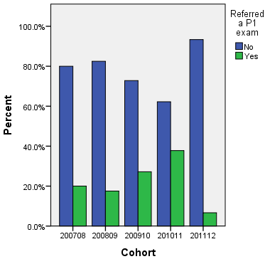
Proportion of students referring a first year core module
Notes:
Data indicate fairly substantial underperformance in the 200910, and particularly 201011 cohorts. Evident from multiple measures of student performance.
A significantly higher proportion of students referred (failed) a module (Pearson’s Chi-square, p=0.01)
NOTE that 201112 cohort has only sat one exam session (two core modules) at this point.

Slide 9
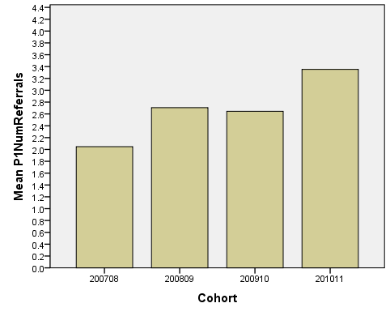
First year referrals per referring student
Notes:
A higher number of referrals (failed modules) per referring student. i.e. more students failed, and each of those failing students failed more modules each.

Slide 10
Across the P1 core modules
First attempts only
Notes:
Trend visible across 3 out of 4 first year core modules. Independent Samples Kruskal-Wallis test found a significant variation between years for each module.
Odd one out is: 1015, Motion & Relativity. Taught by same lecturer for past 3 years (i.e. 200910, 201011, 201112)
Dramatic one is: 1022, Electricity and Magnetism. Change of lecturer between 201011 and 201112.
Introduction of Master Physics is not at same point for each module, and does not correspond with drop in performance.

Slide 11
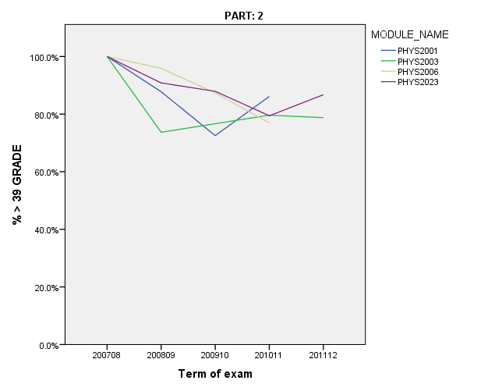
Across the P2 core modules
First attempts only
Notes:
A more mixed picture – so we can neither simply say “201011 was a bad year for all students at any stage” nor “the 201011 cohort were a bad cohort who have gone on to underperform this year too”.
Note though, the 201112 P2 module results necessarily include only those 201011 students who managed to progress onto P2 at all.

Slide 12
Are all students underperforming equally?

Slide 13
Students who passed
First attempts only
Notes:
Among students who passed, the range of marks has remained fairly similar, which suggests that the problem does lie with the underperforming ‘tail’ of cohorts rather than those passing.

Slide 14
How can we explain (and try to predict) variation in student performance?

Slide 15
Correlations with module results
Significant correlation
Further Maths, physics, maths and overall UCAS points
UCAS score relative to school peers
Attendance at labs
No sig. correlation
School type
School performance
Qualification type (A-level, IB etc.)
Taking Further Maths or not
.537 to .594
.324 to .419
.276 to .303
.452 to .548
Notes:
School performance: average UCAS points for student leaving school in the same year as the individual now at Southampton.
Further Maths and attendance at labs: these are LARGE effect sizes.
Also: students who refer more likely to refer again, or re-take a year. (Fairly obviously).

Slide 16
Modelling student results
Most successful linear regression model for module results uses:
1st year lab attendance
Further Maths score
Maths, Physics and Overall UCAS scores
Cohort year
Explains between 43% (Phys1013) and 58% (Phys1015) of observed variance in module results.
Notes:
Based on correlations found, relevant factors were used to construct regression models of students’ module results.
Problem with this: although Further Maths score is an excellent predictor, not all students take it, and it cannot be made part of an offer … Hypothesise that FM encompasses a measure of both academic ability and academic engagement. To replace it, tried using indicator variable for students’ maths and physics grades, i.e. ‘AA’ or ‘non-AA’.

Slide 17
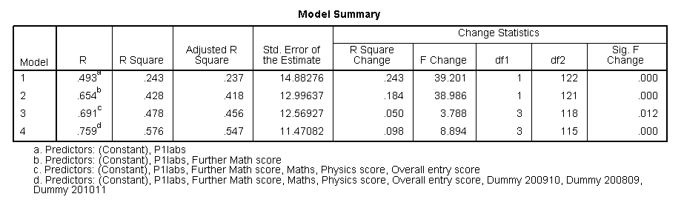
Example – Phys1015
Notes:
Striking that Cohort year still adds to explanatory power of model even when Lab attendance and A-level grades are controlled for. Suggests factors inherent to the experience of that cohort are relevant, whatever they are.

Slide 18
Modelling student results
Next best linear regression model (with no Further Maths):
1st year lab attendance
Maths, Physics and Overall UCAS score
Cohort year
Explains between 43% (Phys1015) and 47% (Phys1011) of variance in student module results.
Notes:
Similar results (40%-46% variance explained) by reducing A-level scores to a simple ‘AA’ or ‘non-AA’ indicator variable.
Grouped students by offer in maths and physics: AA, A-nA, nA-A, nA-nA. This grouping reveals a large difference in results and is relevant to admissions decisions at Southampton.
Next: is it plausible that these differences explain the changes seen?

Slide 19
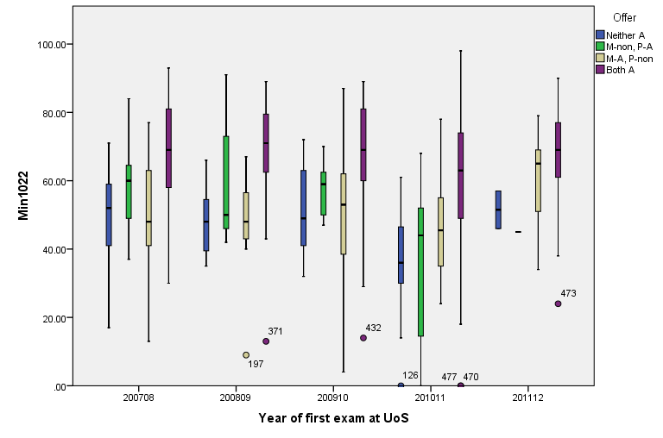
Performance of students with different offers, PHYS1022
Notes:
With regression models in mind, went back to look at the performance of different offer groups over the different years.
Q: are the factors identified and effective in the regression model plausible candidates for what caused the 201011 ‘dip’?
Here, for Electricity and Magnetism. Clear that in 201011, the students referring modules were those without A in A-level maths (they are below the red line).

Slide 20
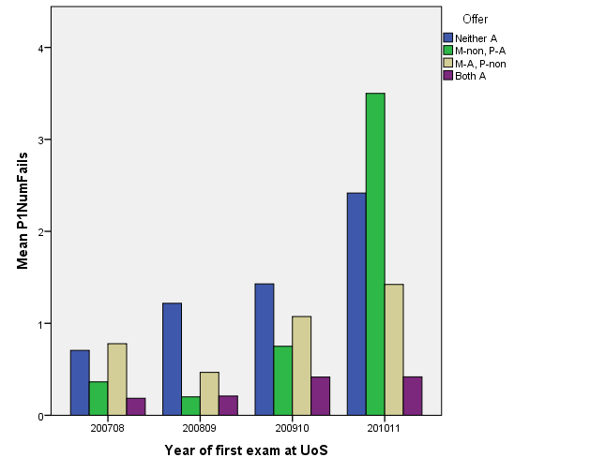
Performance of different offer groups
Notes:
BUT: there is interaction of Offer with Cohort year: not all groups of students failed in the same ways.
Whilst AA students did fail more often in 200910 and 201011 than previously, the difference is slight.
In contrast, all non-Maths-A students (green and blue) failed significantly more in 200910 and 201011 than previously. So the effect of ‘year’ does not affect all groups equally.

Slide 21
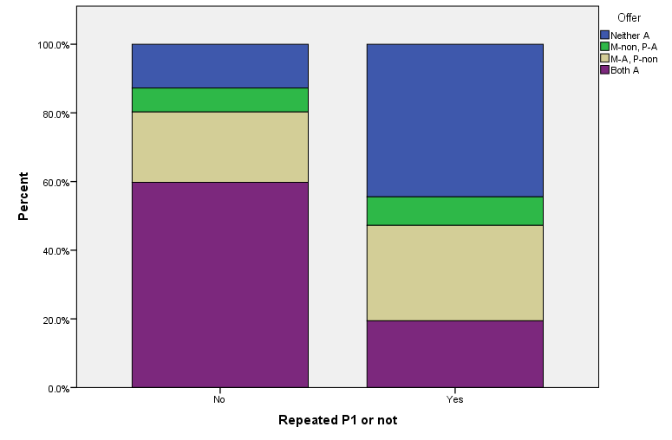
Students repeating P1, by offer

Slide 22
Can these factors explain the ‘drop’ in performance seen in 200910 and 201011?

Slide 23
Performance of students with different offers, PHYS1022
Notes:
Clear that in 201011, the students referring modules were those without A in A-level maths (they are below the red line).

Slide 24
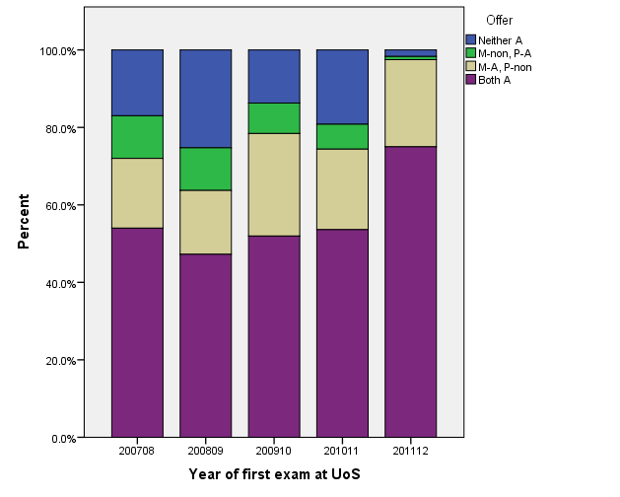
Grades of incoming students
Notes:
Not entirely: statistically significant differences, BUT 200910 actually shows better incoming grades than previous year, and 201011, whilst lower incoming grades than 200910, is still higher than 200809, yet performance is worse.
It is 201112 that differs significantly. Up here [click]. The difference between the previous three years is marginal.
Grade inflation always possible too – a 200708 ‘AA’ may not mean the same as a 201112 ‘AA’.

Slide 25
What changed between cohorts?
No significant differences in:
Proportions of students arriving from different school types
Proportions of students with different prior qualifications (A-levels or other)
Incoming students’ UCAS points compared to their peer group at school
PhySoc parenting scheme
Significant differences in:
Proportion studying Further Maths A-level
A-level scores of cohorts
Size of cohort
Lecturers?
Mastering Physics?
Notes:
Looking at potential sources of difference between cohorts – things that could affect experience of a cohort.
To calculate performance against peers, Department of Education data was collected on the average UCAS score of students at each UK school/institution. The Southampton students’ UCAS scores were then compared to the average UCAS score of a student taking their final exams at that students’ school, for the same year. Care was taken to match deferring/mature students with the appropriate year of data!
Likely that all three of these had effect on the character of the cohort, BUT no single direct relationship, e.g. not the case that results declined in direct proportion to size of cohort.

Slide 26
Conclusions from quant. work
Underperformance concern justified
Further Maths score best single predictor of first year results
Engagement (as measured by lab attendance) highly significant predictor, independent of prior achievement
Highly significant differences in results between offer groups
Cohort year is itself significant
Notes:
If able to continue recruiting AA candidates, seems highly likely that results will remain higher than with more mixed intake.
Further maths – hypothesise that as the most challenging A-level incoming students have sat, this provides the most accurate measure of academic ability and potential, as well as a degree of engagement (have to be academically motivated to study it).
Student with same prior achievement did NOT achieve the same in 201011 compared to 200809 or even 200910.

Slide 27
Qualitative follow up
Physics staff
Core lecturers
Director of Studies
PhySoc committee
President, Secretary etc.
Mentoring Rep
Students
Underperforming
Typically performing
First year coordinator
Informal interviews
6 focus groups
Notes:
Investigate staff and student perceptions of the reasons for success/failure in first year.

Slide 28

Focus groups
~ 6 hours data
T
U
any UG 200910 or later, who referred at least one P1 core module
any UG 200910 or later, who had referred no core modules
Notes:
Will focus on the findings from students and contrast these with the views provided by staff.
Three with underperforming UG students, three with typically performing UG students
4-5 students in each, ~6 hours total data
Key problem: the students who actually volunteered were self-selected and so we can NOT assume they represent all students. In particular, for the underperforming sample, it is reasonable to assume (as has been done in previous research) that the students in the focus groups were more engaged, motivated, pro-active and so on than the average underperforming student.

Slide 29
Focus groups
Transition
Expectations
Induction
Timing of information?
Perceptions of course
Judging progress
Sources of help
Engagement
Reasons for low engagement
Barriers
Academic results
A surprise?
Influence on subsequent behaviour
Minimise researcher influence
Perspectives voiced in own words
Appropriate for exploring shared experience
Supportive
important for discussing referrals/failures
Self-selected
Notes:
Advantages of the focus group
Participants (both U and T type groups) were shown this diagram before we began the focus group discussion. I explained that these areas were the four main topics I was interested to hear their views on, and within those the sort of prompts that I might ask. I began each session by asking students how beginning their physics course compared to their expectations, and from there let the students lead. I asked for clarifications and particularly tried to bring in all students (give all opportunity to speak) but otherwise tried to minimise my influence.
Focus group structure was influenced by points raised by the lecturers I interviewed, and by the research literature on the transitions process, in particular, a previous research project at Leicester looking at first year module failure in Biosciences.

Slide 30
Analysis
Transcriptions of all interviews and focus groups coded in NVIVO
Key themes overall:
Fellow students, especially PhySoc parenting
Level of prior maths
The Mastering Physics online problem sheets
Relationships built in first semester
Notes:
Notably few references to lecturers, cohort size.

Slide 31
Staff perception of reasons for underperformance

Slide 32
Reasons for underperformance
Work level
Personal factors: family, work, partners
Level of prior knowledge, mainly in maths
“students’ success is directly proportional to the amount of work they put in!”
“what determines performance is how hard students put the work in with the worst lecturer”
Notes:
Staff explanations. Can be broadly grouped into 5 areas: work level, prior knowledge, personal factors, motivation for being here, and expectations.

Slide 33
Reasons for underperformance
“Some of our students come here because they want to be physics professors, and some come to university because they want to have fun and are doing physics as their course because they have to do some subject.”
Motivation
Expectations
“if people have somehow been misled about what physics is, have a false impression – there’s not a whole lot we can do about that”
Notes:
Staff explanations

Slide 34
Underperformance – student view
Didn’t do problem sheets
Insufficient or inefficient revision
False confidence from Mastering Physics
Confident that with correct work attitude, would be successful on re-take
Only one student said that module failure has been unexpected; all others “saw it coming”
Notes:
Summary of student’s explicit explanations of failure.

Slide 35
U students on work and revision
For a lot of reasons - I didn't do the work, I was a bit ill before, I thought I could blag it ... but then I went over it again, obviously I had to do a re-sit, and absolutely smashed it, and it was fine.
Notes:
What’s striking: students believe can pass (and do). As found in previous research.

Slide 36
U students on revision
… for me in first year cos I didn't - hadn't really got a revision style, I didn't really do much of it, and then got to the exam and realised how much I still needed to do.
Everyone had been like Oh I'm revising already, and I was like Oh it can wait, it can wait.
Notes:
Often unprepared – comments about “floating through” A-level, a valid point when for many gifted students a thorough revision practice may not have been necessary.
Very clear contrast in attitudes between U and T students. Here, comments from Underperforming students.
LOW LEVEL OF SKILLS

Slide 37
T student on revision
I couldn't revise in the same … physics I had to really change my method. But I was already ... it was really just a shift, away from that and towards more past-paper questions.
Notes:
Here – T student, describes revision at uni as different, and most agreed it required significantly more effort than at school, but her baseline assumptions are that (a) she will have to revise, and (b) she might have to think about how she revises in order to do so effectively.

Slide 38
Mastering Physics
Because you kept doing well in each one of the mastering physics, the tutors never knew that you were struggling - we didn't even know we were struggling!
All bar one student described MP very negatively
Some conceded it could be useful as an additional study tool (not replacement)
Strong assumption that it had been adopted by university as a cost/time-saving measure – although they weren’t cross about it (“I completely understand the academics have other things to do”)
Comments included: deterred collaboration, lulled into “false sense of security”, answers online anyway …
Notes:
Another factor frequently mentioned. Students – all bar one described it very negatively, although some on reflection conceded that it would be a useful “as well as” tool although it was inadequate as a replacement for problem sheets.

Slide 39
Why these different approaches?
Different reactions to ‘difficulty’
Skills not learned already at school
Differing abilities to take advantage of available support
Differing levels of confidence and success in forming relationships with staff and fellow students early on in course
Notes:
Then as to working habits, question: why?
What leads students to not engage with problem sheets, not revise?

Slide 40
Reactions to difficulty
I didn't do any of the problem sheets for the Quantum one cos I found them so difficult to start off with.
On almost every single problem sheet there's been a question or a couple of parts of a question that I just cannot do. Um and you'd go along to the workshop ... [whispers] can't do it!
Notes:
First, U student.
The opposite extreme: a T student who had not been impressed by her first year tutor’s running of tutorials.
I remember doing her problem sheets, and like you'd do a question, really hard, you'd slog through it and get the right answer and it was a real like Yeah! You really felt satisfied. And everyone was like, Oh what did you get, what did you get? It was really good. Whereas with [name’s] were like ppfffffffttttt. To the point where some people - like one of my housemates, there was a question on polarisation, and he stared at it for 45 minutes, before drawing a picture of a polar bear and just handing it in. That is the feeling that [name’s] problem sheets bring on.

Slide 41
Accessing available support
Um it was like I should have asked for more help, but it was being surrounded by people who were like Oh I know all of this, it was very like intimidating.
Well I tagged along to a couple of my friend's tutor sessions cos they'd have really high-level lecturers in the physics department, you know heads of this and heads of research groups, and so I'd just go along to theirs, cos mine were so ... useless!
Notes:
First, U student. Social stigma attached to seeking help; intimidated by other high-flying students; not used to having to ask for help.
The opposite extreme: a T student who had not been impressed by her first year tutor’s running of tutorials.

Slide 42
Accessing available support – relationships matter
Although there's always like, you CAN go to your tutors, unless you have a really good relationship with your tutor, you probably are going to feel a bit like ...
where some of the students knew the PhD guys, they would give them help priority over anyone else, uh just cause they were mates with them.
Notes:
Relationships play a huge role in how students access help (or not). Large variation reported in “how tutors tutor”
Here a second year student talks about having changed tutor.
Relationships going well – perceived by some on the outside to be rather exclusive. If they had not become ‘mates’ with the rest of the department, felt a bit shut out.

Slide 43
Role of maths knowledge
Approximately double frequency of references by underperforming compared to typical students
Both U and T students of the opinion that those without Further Maths are at a significant disadvantage.
Even for students with Further Maths, the transition to using in physics problems is difficult.
Notes:
Very high number of references to maths (note: no prompts by researcher regarding maths at all). Both students and staff felt that maths was key.
This quotation is typical of the FM students spoken to.
This student view corresponds to lecturer’s perception of student difficulties. Maths is a problem!

Slide 44
Further maths
All of the people I've known - all of my close friends, didn't do Further Maths, and where I found first semester really nice slow ease in, they were already having real, real trouble with the maths. So ..
Students did agree that by the time of the maths exam, those without FM had caught up
Notes:
Typical comment

Slide 45
Conclusions from qual. work
Level of maths affects transition experience
Underperforming students frequently had not formed the same initial, strong relationships with peers and older students
Wide variation in tutoring relationships
Student perception of MP is of concern
Students reported little to no induction to do with skills (problem-solving, revision, etc.)
Notes:
Key members of staff aware of problems, and skills Workshops did run until expansion of cohort.
Skills – no induction would be fine if skills already possessed, but by students’ and lecturers’ reckonings, this is not the case.

Slide 46
Overall conclusions so far
Engagement
Good idea of why some students are more likely to underperform than others
No full explanation of why 201011 saw such dramatic underperformance
Significant changes due to cohort year that cannot be directly explained by cohort size
Room to improve transition experience, focusing on students who do not find it easy to form strong initial relationships with fellow students or staff, and on supporting skills.
Offer AA

Slide 47
Recommendations
Support PhySoc in expanding mentoring scheme
Revisit Curriculum Review recommendations on integration of maths, since both students and lecturers agree the problem remains
Clarify expectations of tutors
Review:
The intended replacements for Skills Workshops
Current use of Mastering Physics
Notes:
Mentoring: have willing volunteers already, and struggling students indicated that they would have liked to know that they were available. Underperforming students not emphasise the relationships they had formed with fellow students, tutors or ‘parents’; this was a strong contrast to the typically performing students.
Curriculum review: seems this highlighted many of the issues already.
Large cohort is a problem if it stopped Workshops!
Mastering Physics seems to have the potential to be an excellent aid to learning, but it’s not at all clear it is performing well at the moment. Query whether being used in the way originally intended?

Slide 48
Key references
Black, Fiona M., and Jane MacKenzie. Peer Support in the First Year. Glasgow: The Quality Assurance Agency for Higher Education, 2008.
Budny, Dan, Cheryl Paul, and Beth Bateman Newborg. "Impact of Peer Mentoring on Freshmen Engineering Students." Journal of STEM Education: Innovations and Research 11, no. 5 (2010): 9-24.
Scott, Jon, and Maria Graal. "Student Failure in First Year Modules in the Biosciences: An Interview Based Investigation." Bioscience Education e-Journal 10, (2007).HEA Scotland
Smith, J., and R. Naylor. "Determinants of Degree Performance in Uk Universities: A Statistical Analysis of the 1993 Student Cohort." Oxford Bulletin of Economics and Statistics 63, no. 29-60 (2001).
Trowler, Vicki. Student Engagement Literature Review. The Higher Education Academy and Lancaster University, 2010.
Whittaker, Ruth. Transition to and During the First Year. Glasgow: The Quality Assurance Agency for Higher Education, 2008.

Slide 49
Contact
Jo Williamson
PhD researcher for transitions project
jhw2e10@soton.ac.uk
Dr Andy Gravell
Associate Dean Education and Student Experience, Physical and Applied Sciences
amg@ecs.soton.ac.uk

